Slide 1

HOW TO UPLOAD DOCUMENTS TO SPORTS CONNECT BIRTH CERTIFICATE, REPORT CARD, SIGNED PHYSICAL

Slide 2
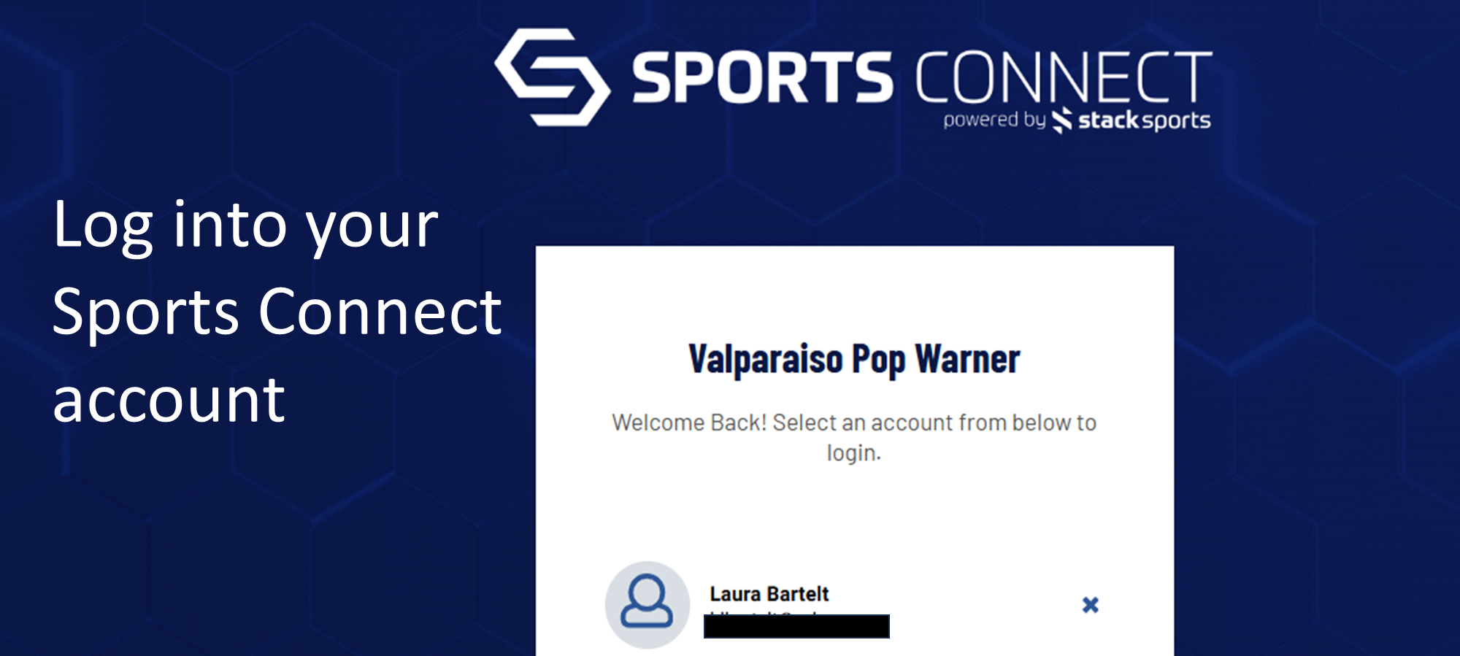

Slide 3
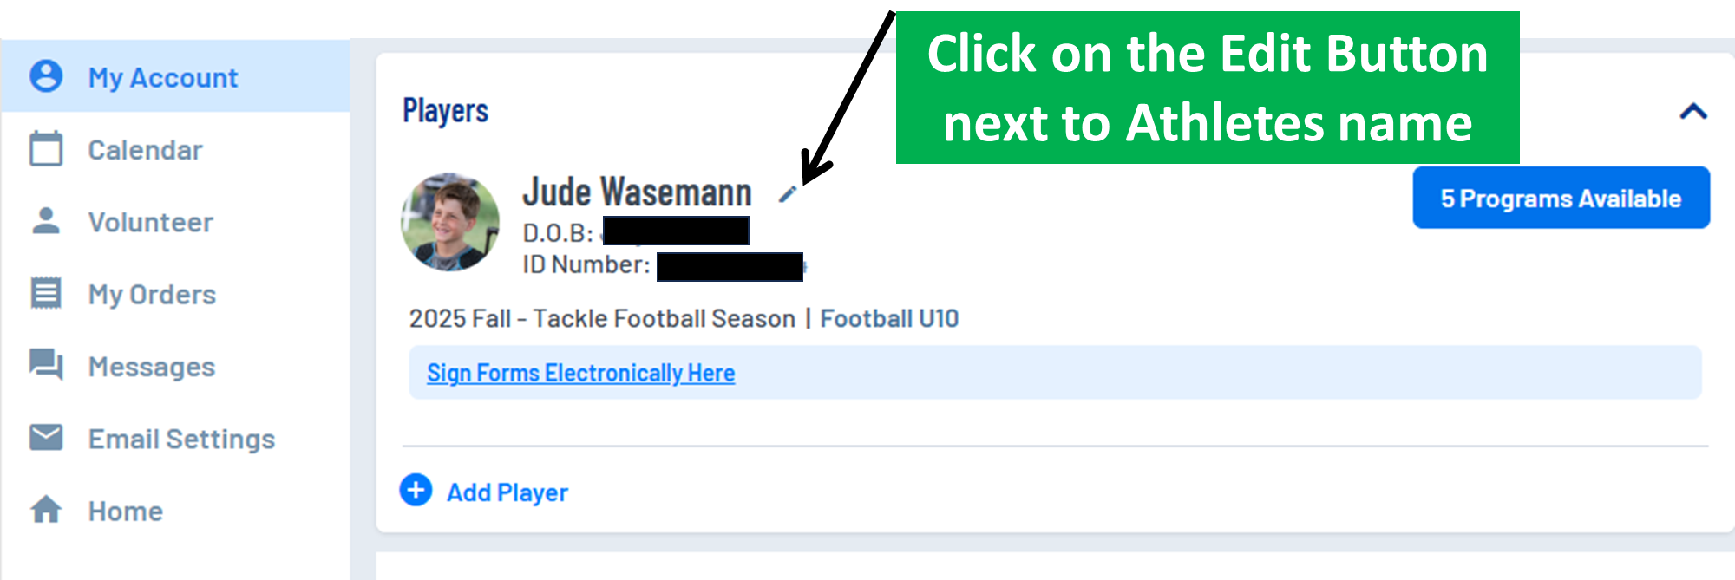

Slide 4
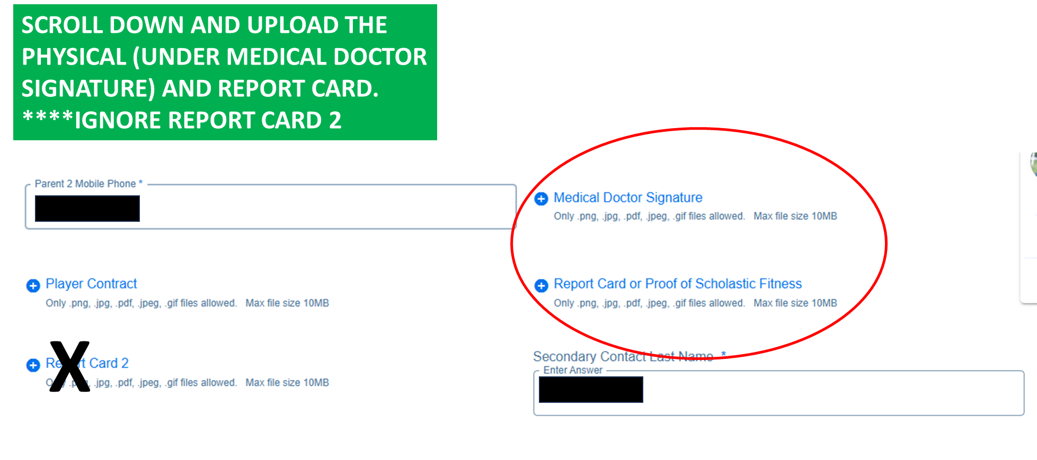

Slide 5
HOW TO DOWNLOAD REPORT CARD FROM SKYWARD

Slide 6
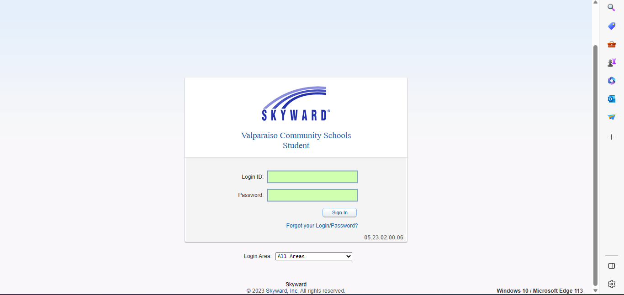
LOGIN TO YOUR SKYWARD ACCOUNT VIA: https://www.valpo.k12.in.us/

Slide 7
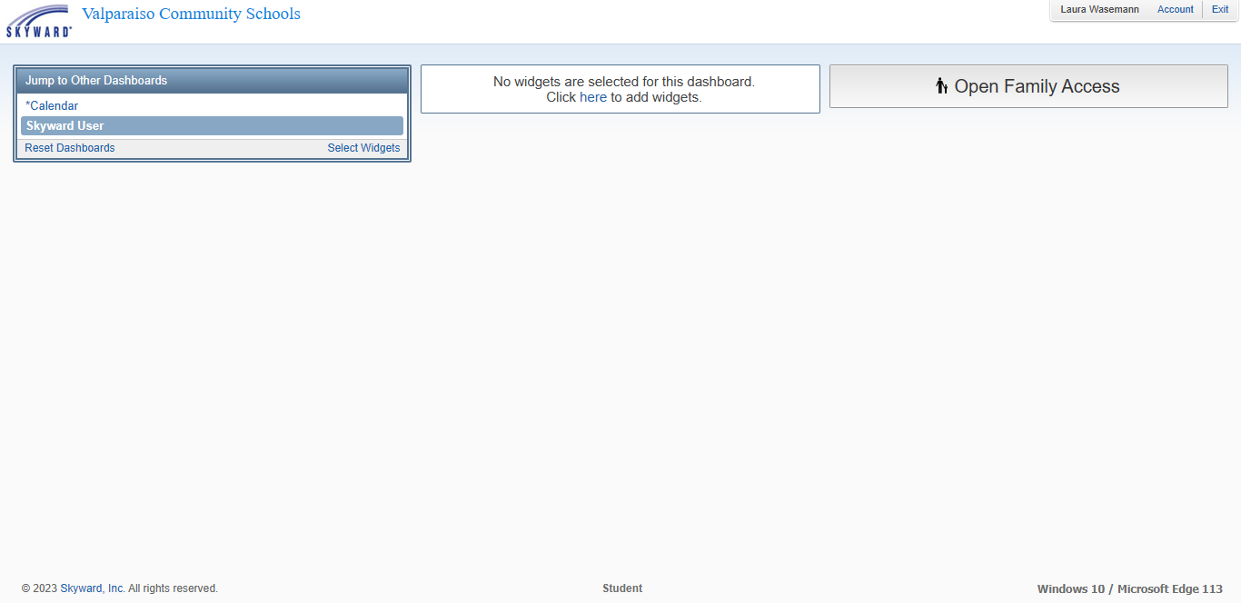

CLICK ON OPEN FAMILY ACCESS

Slide 8
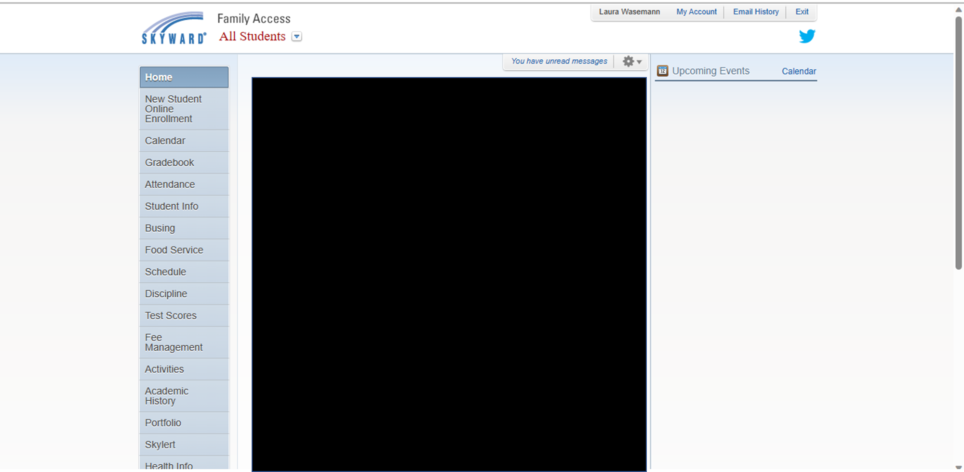

CLICK ON PORTFOLIO

Slide 9
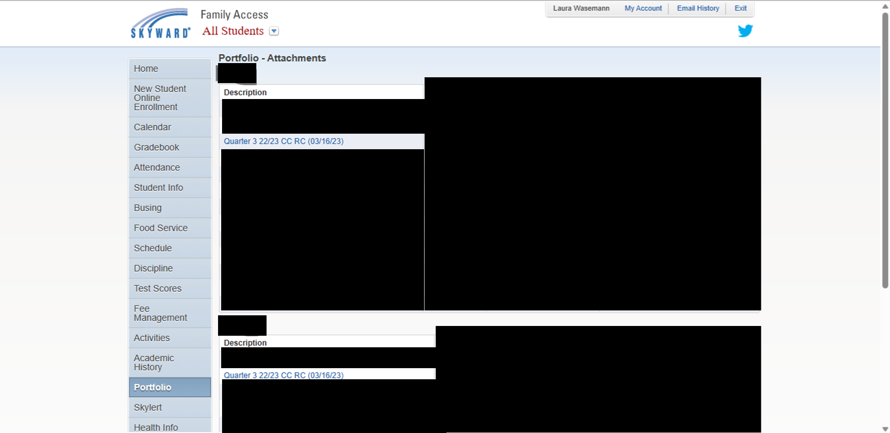



CLICK ON QUARTER 4 CC RC

Slide 10
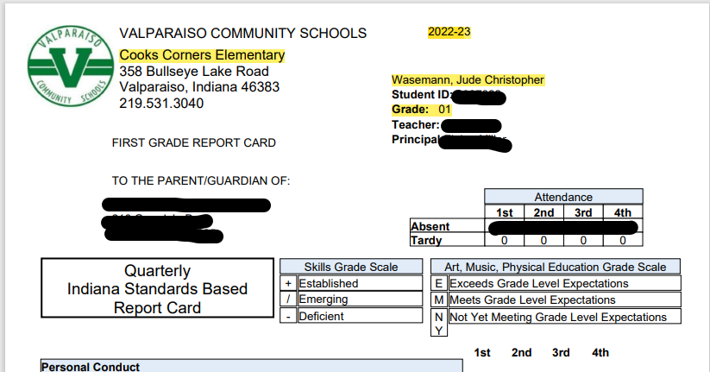

REPORT CARD MUST HAVE: SCHOOL NAME, SCHOOL YEAR, CHILD’S NAME, GRADE LEVEL AND ALL 4 QUARTERS GRADES

